Slide 1


Electric Vehicle Analysis
AtliQ Motors
Pranitha Borigam

Slide 2



Problem Statement
AtliQ Motors is an automotive giant from the USA specializing in electric vehicles (EV). In the last 5 years, their market share rose to 25% in electric and hybrid vehicles segment in North America. As a part of their expansion plans, they wanted to launch their bestselling models in India where their market share is less than 2%. The chief of AtliQ Motors India wanted to do a detailed market study of existing EV/Hybrid market in India before proceeding further. He gave this task to the data analytics team of AtliQ motors.
Tools Used:

Slide 3
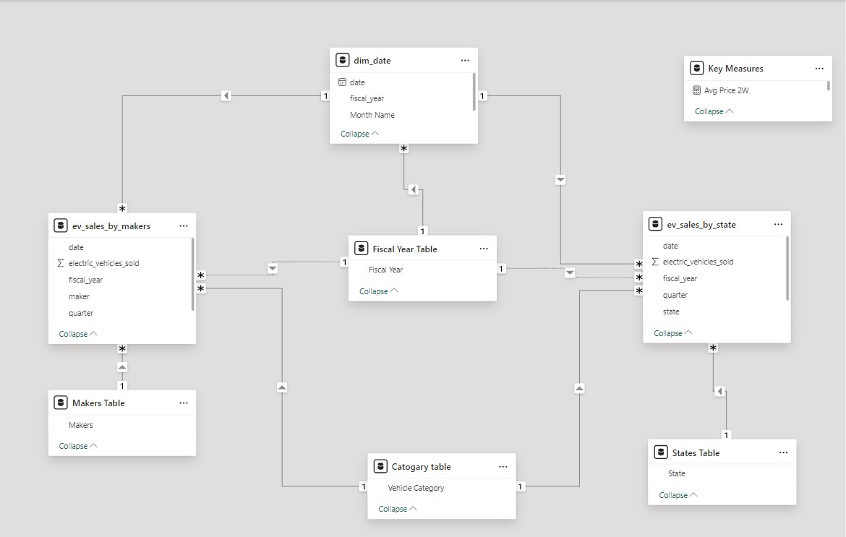
Data Modeling
Data source & Collection
Data Source: Excel CSV Files ( Date Table, EV Sales by Makers, EV Sales by States)
Data Collection: Imported CSV files into Power BI

Slide 4
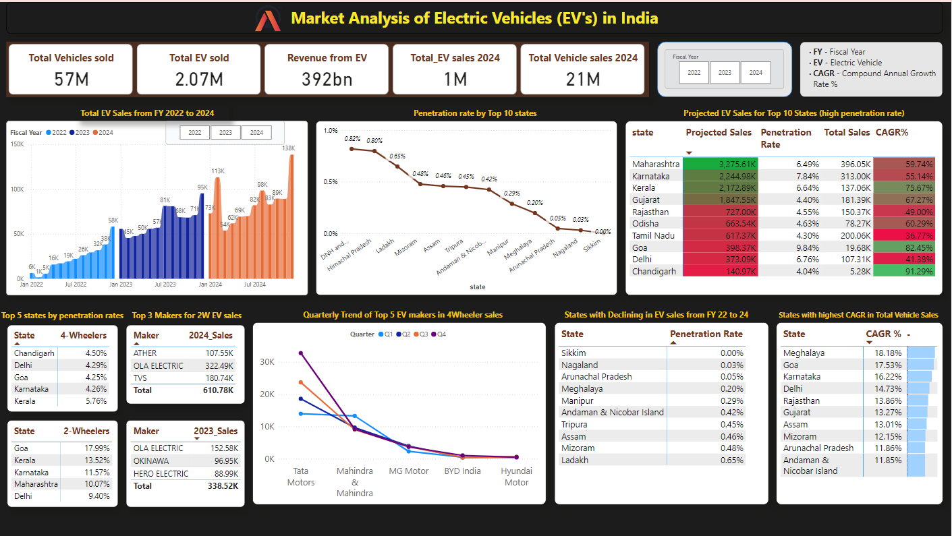
Power BI Dashboard

Slide 5
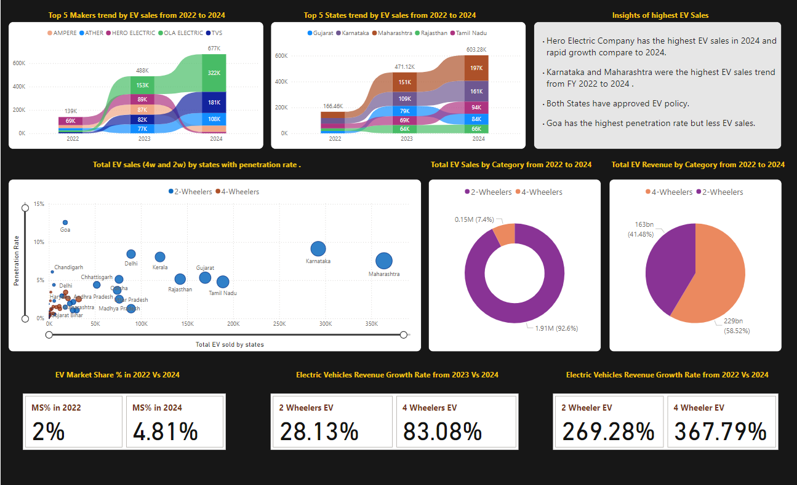

Slide 6
Thank You

